Slide 1
App Builder
Features

Slide 2
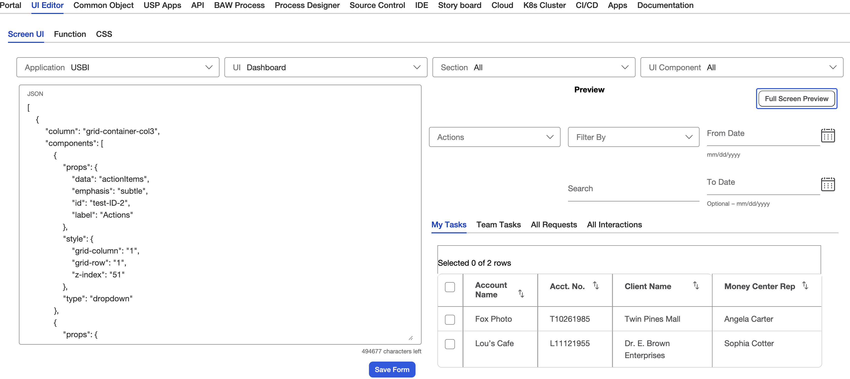
Defining UI
Adding Refresh Button to existing UI created through APP Builder

Slide 3
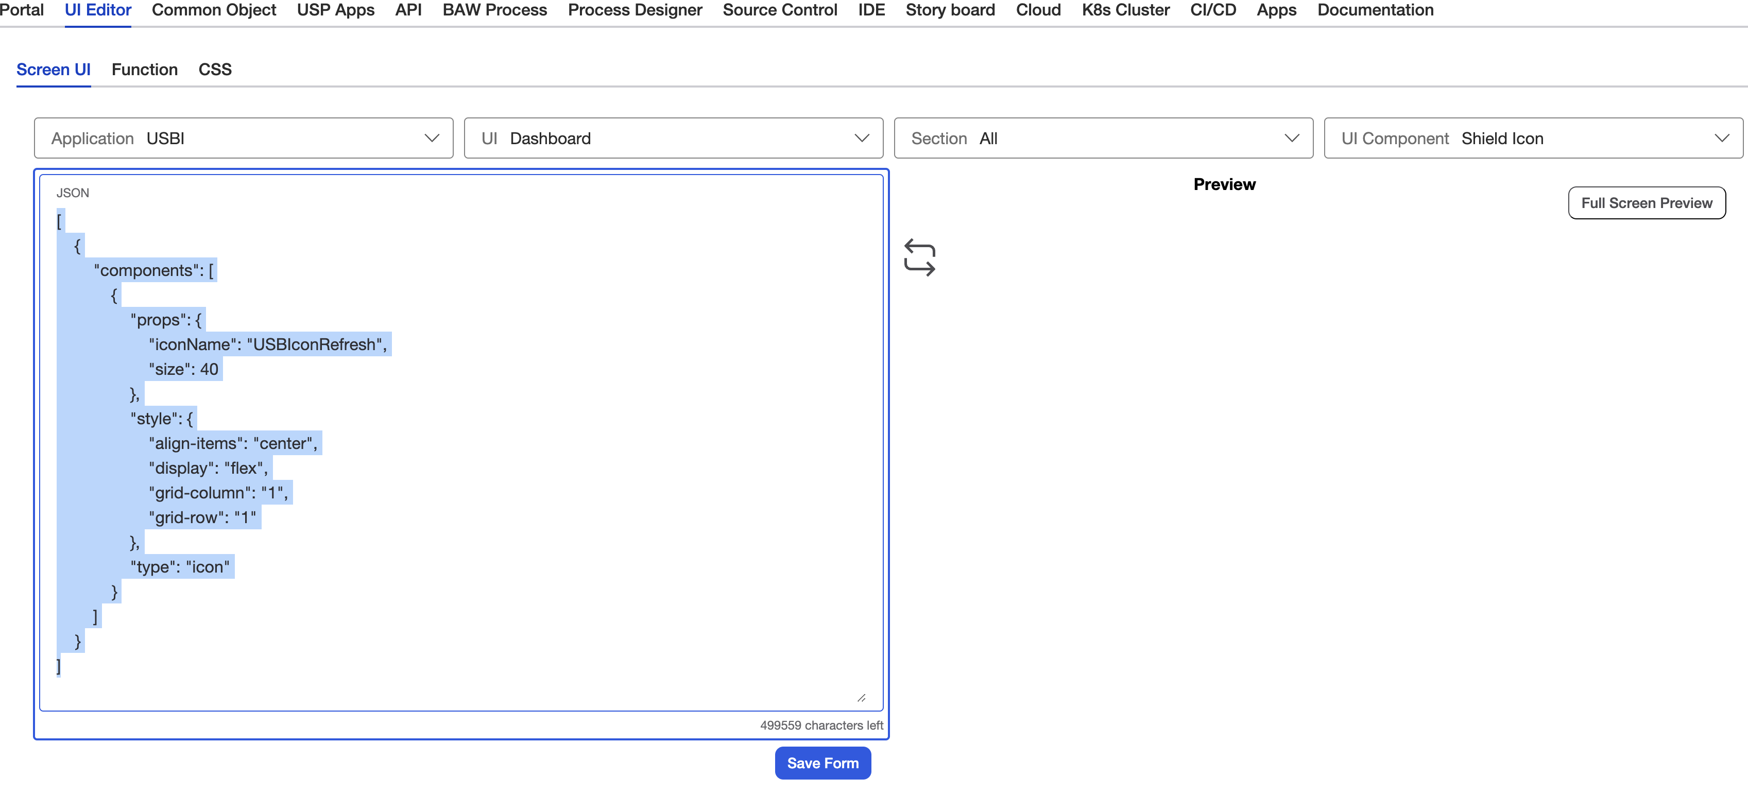
Defining UI
Picking JSON for Refresh Button (Shield Icon)

Slide 4
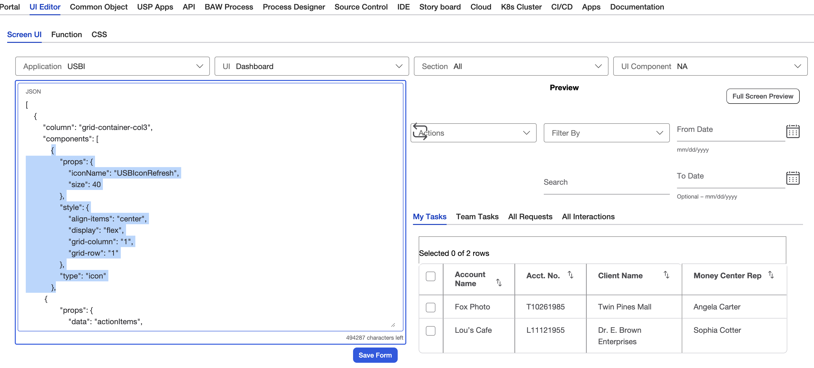
Defining UI
Refresh Button Added but over drop down

Slide 5
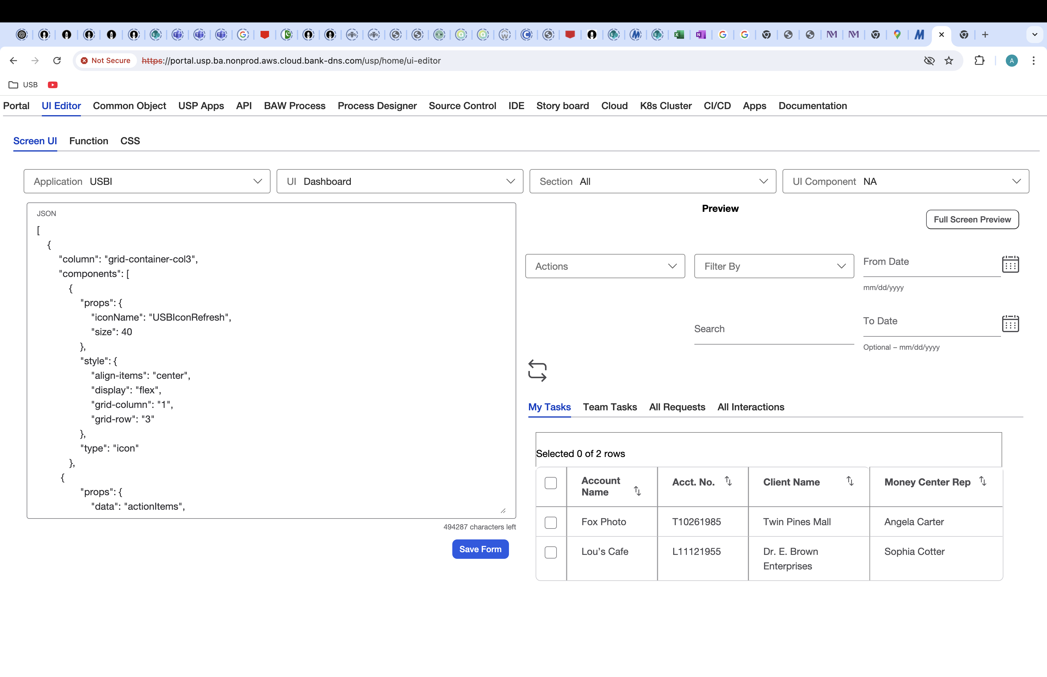
Defining UI
Refresh Button moved to right place by adjusting col to 1 and row to 3 inside 3 column section

Slide 6
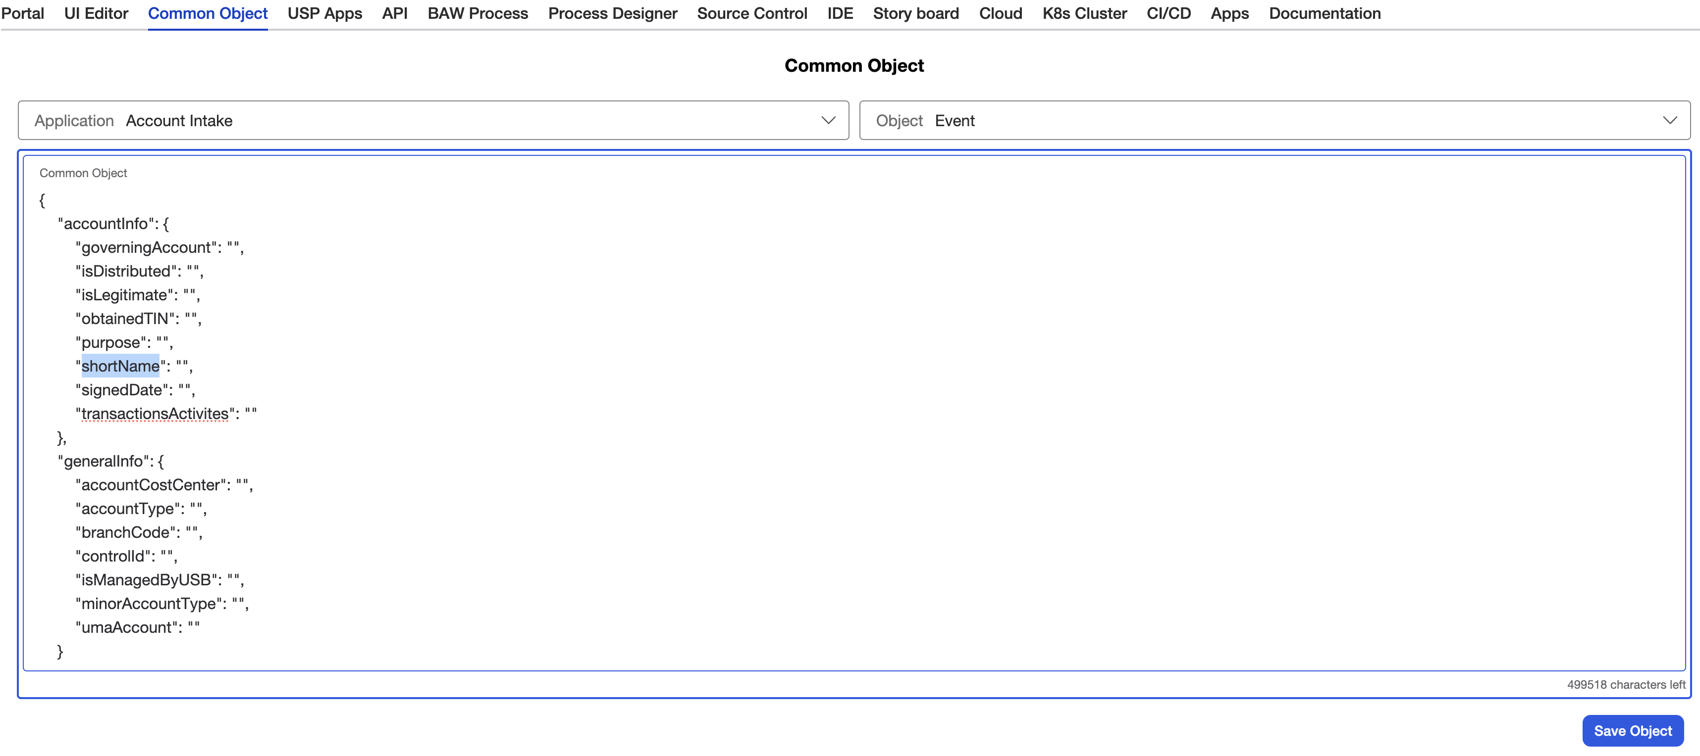
Data Binding
Event object(s) for app is defined here

Slide 7
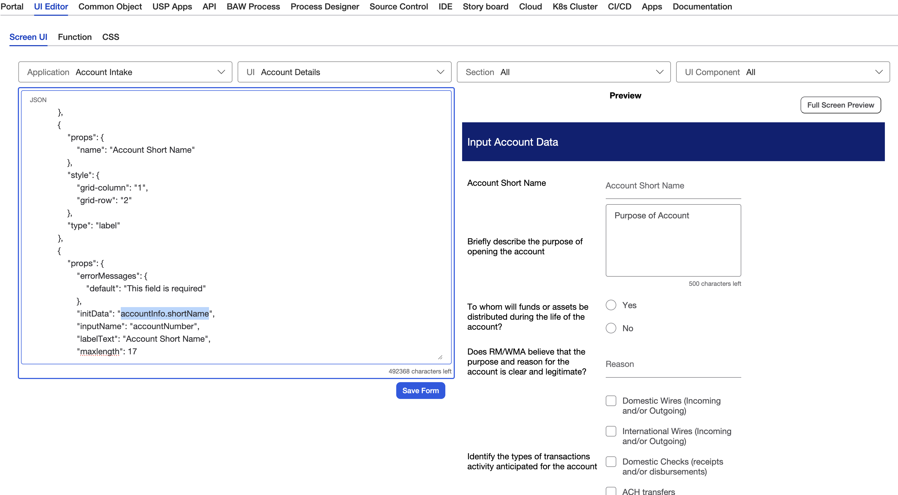
Data Binding
accountInfo.shortName from Event Object is bound to text field

Slide 8
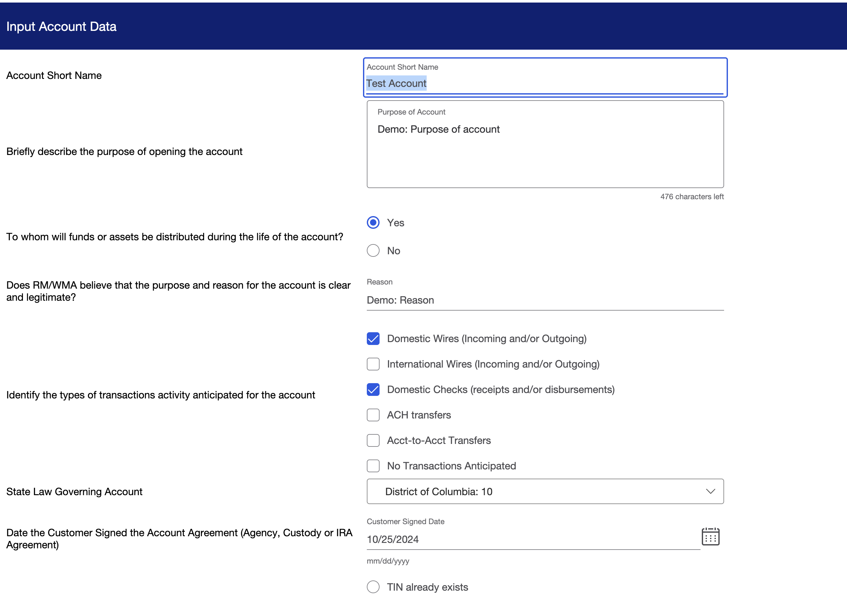
Data Binding
Object field value appears for the text field

Slide 9
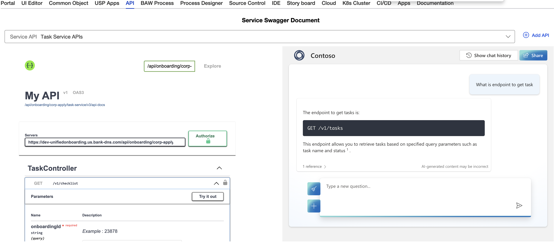
Event Calls/Service Calls
Endpoint for service can be search through Chat GPT like interface

Slide 10
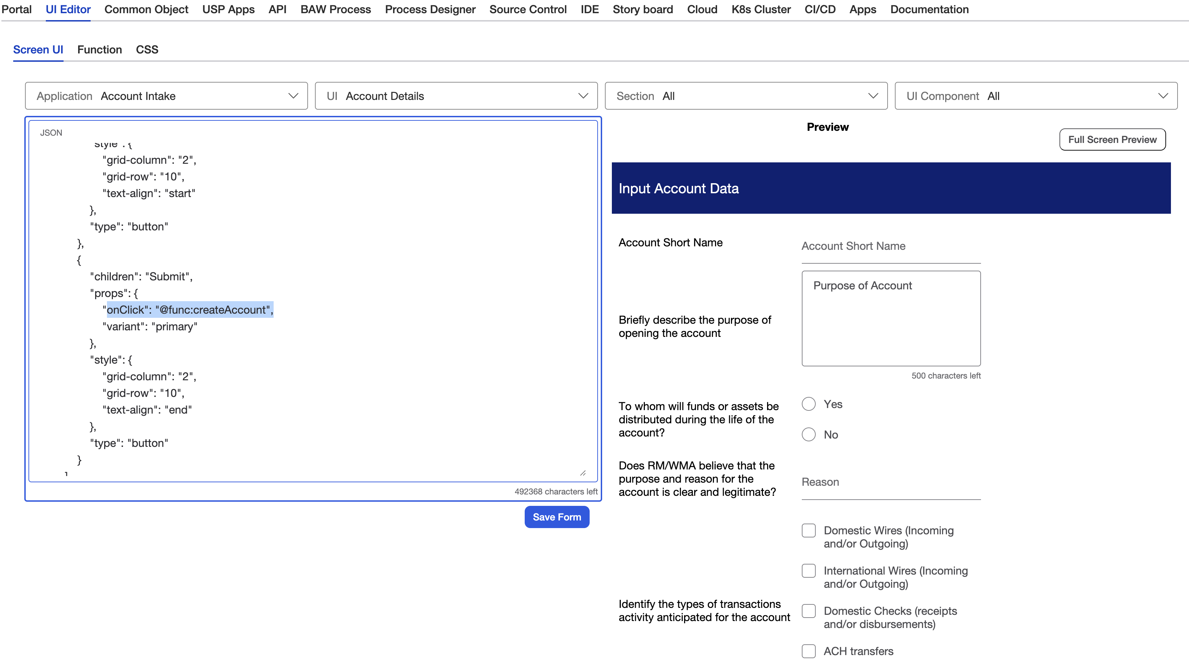
Event Calls/Service Calls
Submit button is linked with createAccount function that will call createAccount service

Slide 11
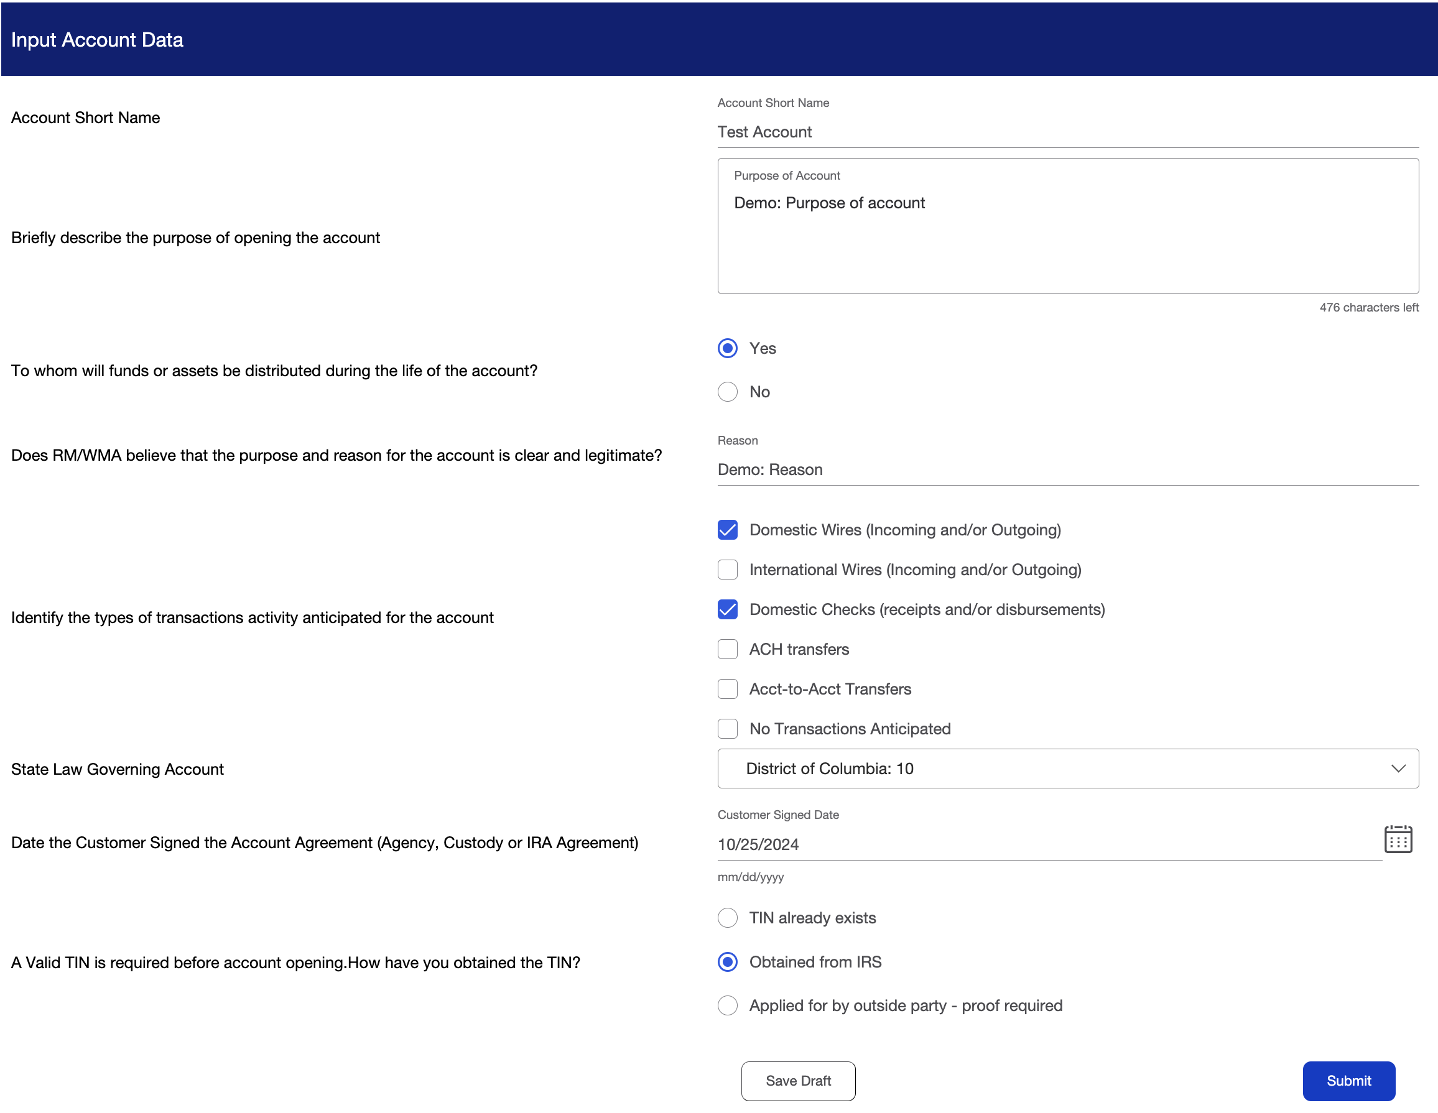
Event Calls/Service Calls
On Clicking Submit button createAccount service will be called to create account

Slide 12
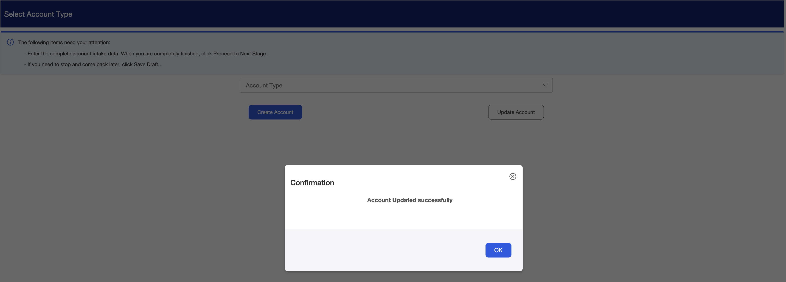
Event Calls/Service Calls
Account is created successfully

